Slide 1
Adv Web Dev Architecture Lecture 2
Amir Amintabar, PhD

Slide 2
Outline
1 Course structure
Course outline
Announcements on the learning hub front page
Assessments, assignments and term project topics
2 What is internet software architecture all about?
3 The architecture we focus on: API-centric, service based
4 JSON as a way of data payload in API communications
1

Slide 3
What is internet software/Application Architecture?
2
Architecture refers to interaction/relation among components.
In building construction: interaction/relation among walls , floors, stairs
Focus is on space usage, flow, beauty, cost, style
In computer architecture: interaction/relation among CPU, Memory, Storage , I/O …
Focus is on speed, power usage, efficiency, computational power
In web application: interaction/relation among UI, Database, logic, etc
Focus is on reliability, scalability, security, ease of implementation, modularity

Slide 4
What are the benefits of studying architectural patterns?
Architectural patterns help us better evaluate the efficiency , robustness, security, performance, modularity, cost of maintenance, development and extension, cost of deployment our designed application:
Efficiency (e.g. I am looking for a lightweight server, what backend technology works for me),
Cost of maintenance (e.g. my application is written in JavaScript and ASP .net, I need two developers. If I switch to nodejs I only need one developer good at JavaScript)
Development and extension (e.g. my client wants me to add this new module to Django , but my Python developer left my company. Can I ask my nodejs guy to create a service and hook it up to Django via API? The answer is yes only if my Django application is originally developed as an API-centric application)

Slide 5
What are the benefits of studying architectural patterns? …
Robustness ( e.g. is there a single point of failure in my design? How the requests' load is distributed among modules. What if the DB fails)
Security ( e.g. how easy I can improve the security? Should I look into every single line of my code, or there is a gateway component I originally designed which is the only portal being in touch with the outside world. That gateway is the only place I need to secure)
Modularity ( e.g. each module/service must carry one main functionality)
Cost of deployment ( e.g. do we need a dedicated server? If we use Ruby on Rails, perhaps we need a dedicated sever. Do we need docker?)

Slide 6
There are many recognized architectural patterns and styles, among them:

Slide 7
Layered (n-Tier) Architecture
layers = functional elements.
Presentation layer (UI layer)
interaction with the end-user is handled(e.g. form page)
Business layer ( business logic)
controls the application’s logic ( e.g. decision making, routing requests)
Application layer
where the core functions of the app is implemented( e.g. libraries)
Data access layer
where access and retrieval of data are handled ( e.g. databases)

Slide 8
Service Oriented Architecture (Microservice)
The components could be each providing a separate. All forming a collection of loosely coupled (almost independent) services. When a service reaches a specific level, it could be created in the form of a separate, stand alone app.
We could as well split the services into smaller pieces so that each service executes a single functionality called microservice.
Each service can reside in a separate machine. Be written in a different technology stack and can be up and running separately. For example the messenger app is a service to the facebook app. If facebook shuts down, it does not necessarily cause the messenger app to shut down too SOA: Service-Oriented Architecture MSA: Microservice Architecture slightly different but refer the same thing in this course

Slide 9
Monolithic Architecture
Opposite to microservices is monolithic architecture where in this context, means composed all in one piece.
A monolithic architecture is the traditional unified model for the design of a software program. Often entire software resides in one machine, entire software is written in one backend technology stack.
For example in a monolithic web application entire application is usually written in one backend technology, say Java and hosted in one machine. If you want to add something new to it you
1- shut down entire application
2- add the new feature
3- ( may need to ) recompile everything before deployment
All application logic (UI, business logic, data access) is bundled together in a single deployable unit. Simple to build and deploy but hard to scale and maintain as complexity grows.

Slide 10
Microservice arch. pros and cons
Pros:
It enables you to add new components to the system and fix any bugs without shutting everything down.( you can fix messenger app without shutting down facebook)
One service is meant to be responsible for one function (for example, messaging, uploading files, registering users, and so on). That’s why you can assign different teams to work on each service and thus speed up the development process
Cons
Its complicated compared with monolithic. Since each service could be hosted in a different part of the globe, the only way the services can communicate is via API. Thus you have to deal with so many API calls!
Nonetheless, many large firms choose the Microservice architecture: Uber, Netflix, Amazon, Ebay, Sound Cloud, Groupon, realtor.com ( Richmond BC)
Breaks the system into small, independent services, each responsible for a specific business capability.Improves scalability and flexibility but increases operational complexity.

Slide 11
Summary and more by ChatGPT ( we need to verify )
1. Monolithic Architecture
Purpose: Quick to build and deploy for small apps or MVPs.
Best for: prototyping, or apps that don’t expect frequent independent feature updates(Q: why not suitable for this?)
2. Layered (n-Tier) Architecture
Purpose: Enforces separation of concerns (UI, business logic, data).
Core banking platforms separate UI, business rules, and data persistence. This layered design ensures strict regulatory compliance, testability, and maintainability across millions of transactions.(Q: What's especial about banking platforms that we need to separate data from business ?

Slide 12
3. Microservices Architecture
Purpose: Split complex systems into independently deployable services.
Best for: Large-scale systems needing high scalability, agility, and independent team ownership (Netflix, Amazon Q: who else?).
4. Event-Driven Architecture
Purpose: Trigger actions asynchronously via events (publish/subscribe model).
Best for?
Q: Example?

Slide 13
5. Serverless / Function-as-a-Service (FaaS)
Purpose: Run small, stateless functions in the cloud without managing servers.
Best for: Apps with unpredictable traffic (the server is developed by someone else and made available to you via API calles) tasks like image processing throw sending API request to an image server, vending machine payments
Example: apps you developed in term one where you had no server side scripting involved
6. Model-View-Controller (MVC)
Purpose: Organize code into UI (View), logic (Controller), and data (Model).
Best for: Web frameworks (Django, Rails, ASP.NET MVC) — good when app logic is closely tied to views (Q: what does this mean?). GitHub was originally built on Ruby on Rails (MVC).(true?)

Slide 14
7. Model-View-ViewModel (MVVM)
Purpose: Improve UI separation, enable two-way data binding.
Best for: Rich client-side apps with reactive UIs (Angular, Vue, React with state management).
Real-Life Example?
8. Micro-Frontends
Purpose: Break large front-end apps into smaller, independently deployable parts.
Best for: Enterprises with multiple teams contributing to a single large front-end (e-commerce sites, dashboards).
Real-Life Example: Spotify uses micro-frontends to scale different parts of its web player.(true?)

Slide 15
9. Hexagonal Architecture (Ports & Adapters)
Purpose: Decouple core business logic from external systems (DBs, UI, frameworks).
Example: Lufthansa Systems (aviation software)
They use hexagonal architecture to decouple flight scheduling logic from databases, UI, or external APIs. This makes systems testable, reliable, and adaptable to new data sources.
10. CQRS (Command Query Responsibility Segregation)
Purpose: Optimize performance by separating write (commands) from read (queries).
LinkedIn ? uses CQRS in its feed and messaging systems. Write-heavy actions (posting updates, sending messages) are handled separately from read-heavy queries (loading millions of feeds), ensuring performance at scale.

Slide 16
Can we utilize multiple architectural pattern into one products ?1/3
Most big companies don’t stick to just one architecture — they evolve over time and mix patterns depending on the system’s needs. (examples from ChatGPT – to verify)
Netflix
Started: Monolithic (early DVD rental days).
Now: Microservices for core streaming (recommendations, billing, video encoding).
Also uses: Event-driven patterns for streaming telemetry, CQRS for separating user actions (e.g., play, pause) from analytics queries.
Netflix shows how companies don’t stick to one architecture. They evolve: Monolith → Layered → Microservices → Event-driven + CQRS as scale and complexity increase.
Spotify
Front-end: Micro-frontends (different teams ship UI parts independently).
Back-end: Microservices (recommendations, search, music catalog).
Also uses: Event-driven patterns for real-time activity feeds (“Your friend is listening to…”).

Slide 17
Can we utilize multiple architectural pattern into one products ? 2/3
Alibaba
Front-end: MVVM (Vue.js for rich, reactive UIs).
Back-end: Microservices to support large-scale e-commerce operations.
Also uses: Serverless (Alibaba Cloud’s Function Compute) for handling burst traffic on events like Singles’ Day sales.
LinkedIn
Core: CQRS for feeds and messaging (separating reads/writes).
Also uses: Event-driven architecture for notifications, microservices for modular scaling, and hexagonal architecture patterns in some domain-driven designs.

Slide 18
Can we utilize multiple architectural pattern into one products ? 3/3
Coca-Cola (IoT / vending machines)
Uses: Serverless (AWS Lambda) for vending transactions.
Also uses: Event-driven workflows for telemetry and inventory reporting, plus microservices for backend processing.
Lufthansa Systems
Core: Hexagonal architecture (domain-driven flight scheduling). Q: Why Hexa?
Also uses: Layered architecture for ERP-like internal tools, event-driven systems for real-time flight updates.
Uber
Started: Monolithic Ruby on Rails app.
Now: Migrated to Microservices to scale different domains (maps, payments, ride matching).
Also uses: Event-driven architecture for real-time ride dispatch and pricing updates.

Slide 19
What we study in this course An API-Server with service based architecture which is also RESTful Q: it fully rests ?
3

Slide 20
Web architecture we use to develop our app in this course
services
Clients
We practice a simplified version of Microservice architecture (MSA)
We design an API centric MSA
API: API calls follow RESTful architecture
Different origin:
Clint and servers are not hosted on the same machine
( HTML files and nodejs files are not in the same machine).
Even services might not be hosted in the same machine.
Response:
Responses coming back from services are often in JSON format
AJAX API calls
API gateway
Client scrips (HTML, AJAX)
JSON
Client scrips (HTML, AJAX)
Korea
inventory service
UAE
user profile service
file
service
…
USA
Japan

Slide 21
Learning outcome we seek from developing API centric architecture
Design and develop programs using REST, JSON and HTTP.
Learning the RESTful API architecture
Working with HTTP methods (GET, POST, PUT etc)
Working with JSON as a format to pass data back and forth
Design a simple web service.
A simple web service that returns result to AJAX requests like mydomain.com/API/Patients/1
Design and develop a RESTful API by applying the best practices and REST constraints.
You practice this in one of your labs and in your term project
Document and write specifications.
using swagger

Slide 22
Practice implementation of CRUD operations.
Review of RDBM
Doing Create, Read, Update and Delete operations on a database via API requests
Implement error handling, HTTP status codes, secure API.
404, 303, 200, 505, …with messages such as
Bad request
Unauthorized
Not found
Apply change management and versioning of designed APIs.
mydomain.com/V1/API/Patients/1
mydomain.com/V1.1/API/Patients/1
Secure a backend API server.
simple token based approach
Hashing using promises

Slide 23
Also
Working with web storage
Private key/ public key
Asynchronous programming
Practicing denial of service attack
How to design scalable applications
How oAuth works
You may need to install SSL ( depends on your host provider how to do it)

Slide 24
Lets get started ….

Slide 25
JSON and HTML Web Storage
4

Slide 26
Web Storage ( inside your browser, not server)
We want to store data locally within the user's browser.
Before HTML5, application data had to be stored in cookies.
Web storage is more secure, and large amounts of data can be stored locally ( generally a couple of mega bytes, 5MB or up) .
Note that web storage is per origin! That means per domain and protocol.
All pages, from same origin, can store and access the same data within same browser on your computer of course.
It is a client thing (in your browser's local data)
Web storage is client-side storage, which means it resides in the local data storage of your browser

Slide 27
localStorage vs sessionStorage
There are two HTML web storage objects for storing data on the client:
window.localStorage - stores data with no expiration date
window.sessionStorage - stores data for one session (data is lost when the browser tab is closed)
Since it is a new thing, check browser support for localStorage and sessionStorage before using web storage, :
if (typeof(Storage) !== "undefined") { // Code for sessionStorage/ localStorage. } else { // Web Storage is not supported in this browser.. }

Slide 28
The localStorage Object
no expiration date.
The data will not be deleted when the browser is closed
will be available the next day, week, or year.
Example
// Store localStorage.setItem("myKey", "Monday and Friday");
// Retrieve localStorage.getItem("myKey");
Note: Name/value pairs are always stored as strings. Remember to convert them to another format when needed!

Slide 29
Example
You write stuff in a browser tab ( open writer.html)
reader.html reads the same stuff written(stored) by writer.html next day or same time in different tab

Slide 30
The localStorage Object Example/ writer.html
This code snippet writes something onto local storage
<html lang="en">
<body>
<script>
const msg_notSupported = "Sorry web Storage is not supported!";
const msg_key = "hidden secret";
const msg_written="A piece of data was written in local storage for the key:";
if (typeof (Storage) == "undefined") {
document.write(msg_notSupported);
window.stop();
}
localStorage.setItem(msg_key, "2021");
document.write(msg_written+msg_key);
</script>
</body>
</html>

Slide 31
The localStorage Object Example/ reader.html
This code snippet tries to read from local storage ( remember same domain, same browser, same machine)
<html lang="en">
<body>
<script>
const msg_notSupported = "Sorry web Storage is not supported!";
const msg_key = "hidden secret";
const msg_read="stored data for the key ";
if (typeof (Storage) == "undefined") {
document.write(msg_notSupported);
window.stop();
}
document.write(msg_read+msg_key+":"+localStorage.getItem(msg_key));
</script>
</body>
</html>

Slide 32
Question!
How can I store the entire object into the local storage ?

Slide 33
JSON JavaScript Object Notation

Slide 34
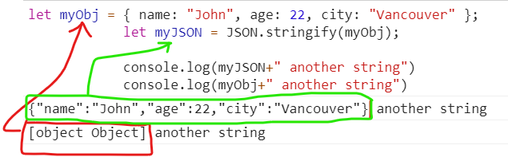
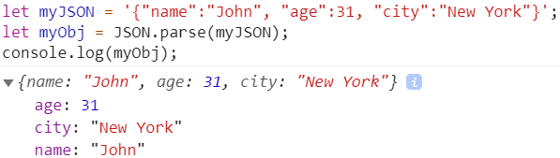
JSON or JavaScript Object Notation
1. You can flatten a JavaScript object into a JSON string and send it to another computer over the net.
let myObj = { name: "John", age: 22, city: "Vancouver" };
let myJSON = JSON.stringify(myObj);
console.log(myJSON + " another string");
console.log(myObj + " another string");
Q: What is the type of myJSON here?
As you have noticed, json behaves like a flat string
See the result of concatenating it with another string .
2. At the other end the json string can be parsed back to an object:
let myJSON =
'{"name":"John", "age":31, "city":"New York"}';
let myObj = JSON.parse(myJSON);
console.log(myObj);

Slide 35
More programming Tips
5

Slide 36
Using same event handler for multiple buttons! (based on JavaScript closure)

Slide 37
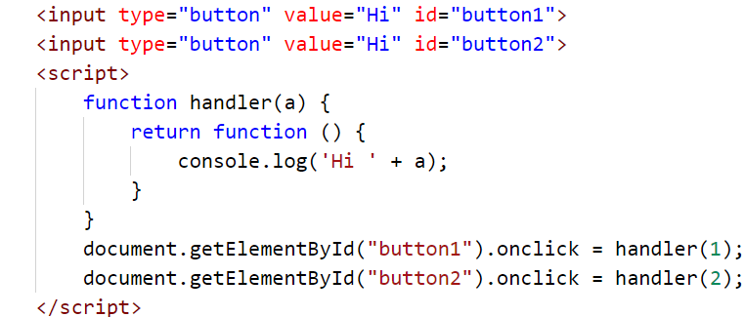
Passing parameters to Event handlers
Remember we said if function name is followed with brackets, it gets executed immediately e.g. myFunc().
A function can return a number, a string , a Boolean or even a function!!!
Yes a function in JS can return a function!!!!
Based in these two here is an example where parameters were passed to same function handling events for two buttons:
This is based on a feature of JavaScript called closure.
Variable a is assessable in the function returned by the enclosing function

Slide 38
Object constructor with methods ( another example was given in lecture 1)

Slide 39
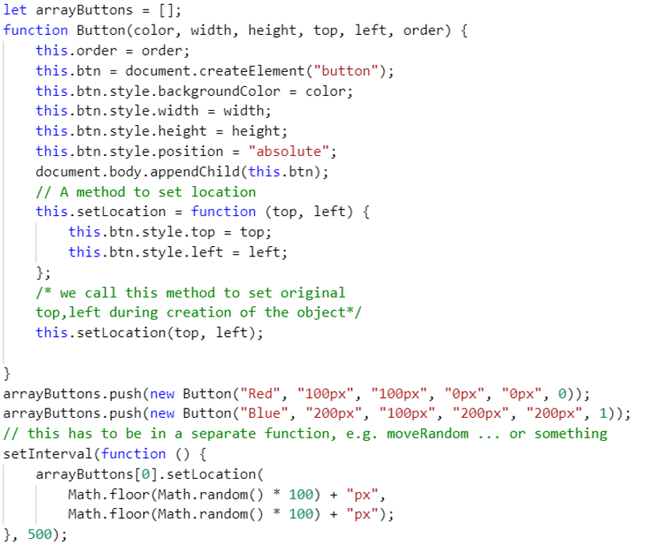
Example: Object constructor with methods (this is old way, you can now use classes in JS)
Q: What does this code snippet do?

Slide 40
References
https://gearheart.io/articles/how-build-scalable-web-applications/
https://www.cleveroad.com/blog/web-application-architecture
https://stackify.com/web-application-architecture/
https://en.wikipedia.org/wiki/Software_architecture
https://www.jinfonet.com/resources/bi-defined/3-tier-architecture-complete-overview/
https://www.oreilly.com/library/view/software-architecture-patterns/9781491971437/ch01.html
https://www.sciencedirect.com/topics/computer-science/presentation-logic
https://lanars.com/blog/web-application-architecture-101
ChatGPT was used for proofreading and content generation too

